Slide 1
Hospital Management System
Srimanth (RA1911029010064)
Sherwin (RA1911029010079)
Raghul Akash(RA1911029010102)

Slide 2
ABSTRACT
This project Hospital Management system includes registration of patients, storing their details into the system, and also computerized billing in the pharmacy, and labs.
The software has the facility to give a unique id for every patient and stores the clinical details of every patient and hospital tests done automatically.
It includes a search facility to know the current status of each patient.

Slide 3
Introduction
The main purpose of the system is to Design and maintain a database of the patient as well as employee details of the hospital.
It also includes the patients’ appointment, billing information, lab tests, disease history.
Besides, it also converts all paper works into digital form.

Slide 4
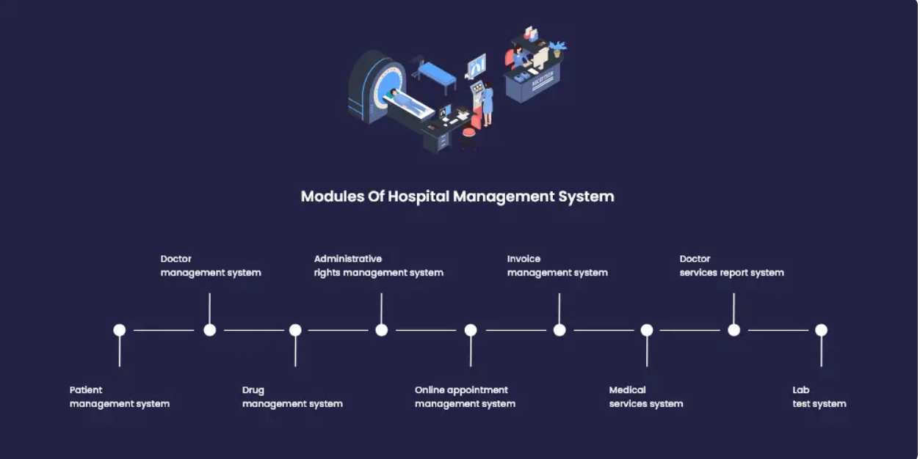
MODULES

Slide 5
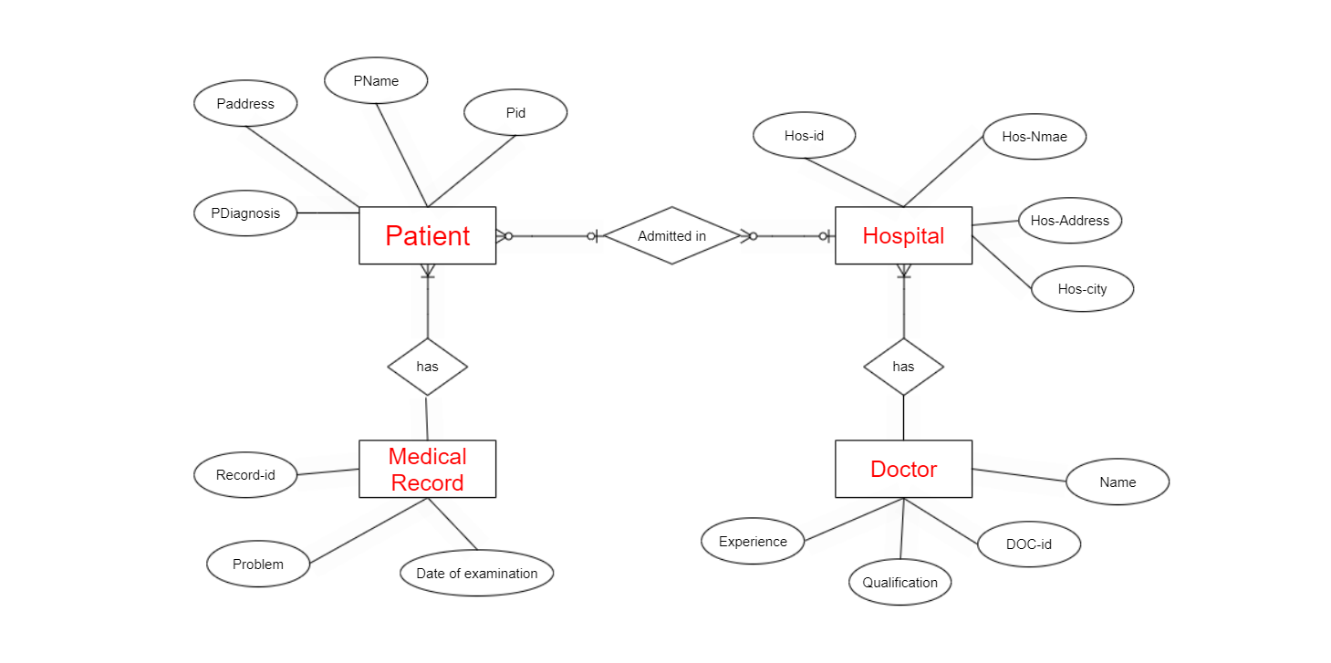
ER Diagram

Slide 6
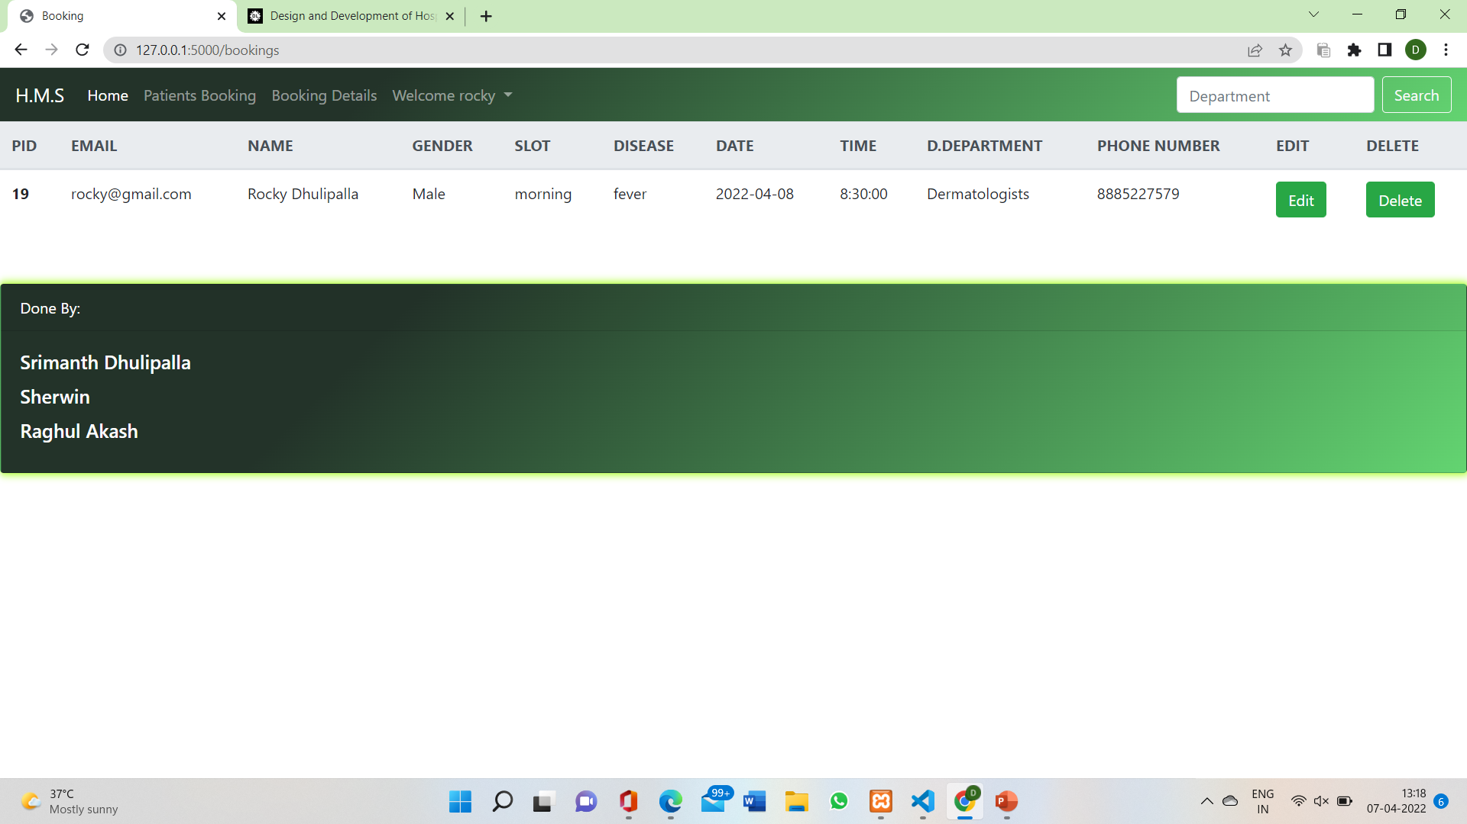
INTERFACE

Slide 7
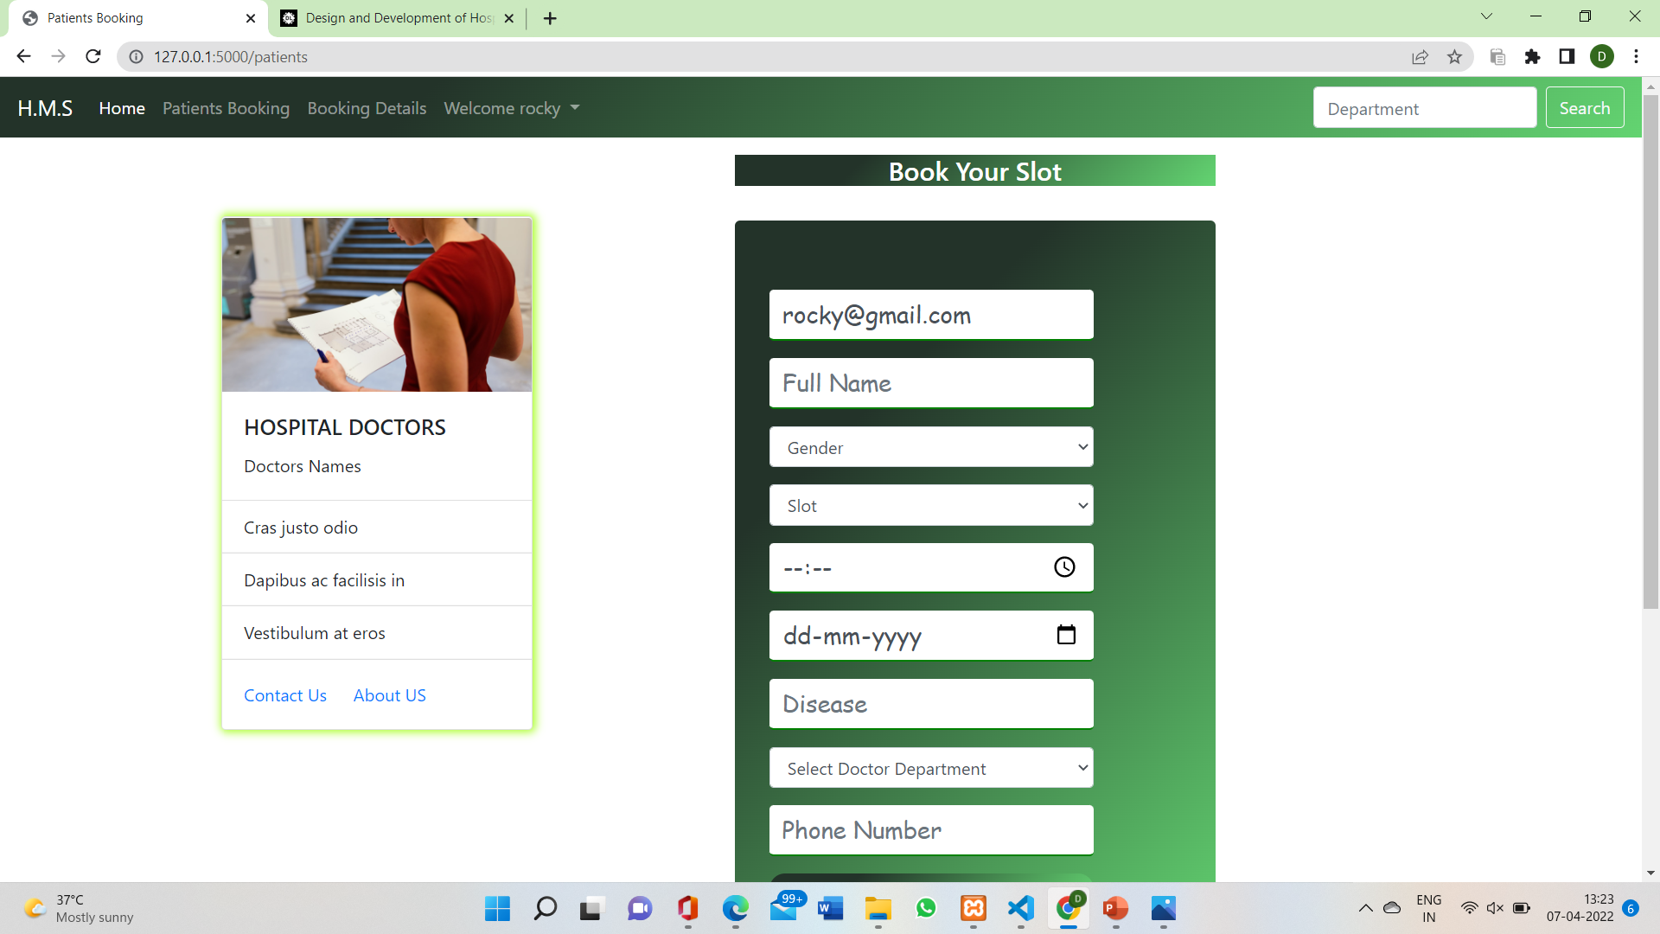

Slide 8
ADVANTAGES
Digital medical records reduce the errors and records each data in detail
Provides easy access to patient history
Improves efficiency of the staff
The main advantage is it eliminates the risk of “lost files”.

Slide 9
CONCLUSION
It automates numerous daily operations and enables smooth interactions of the users.
Developing the hospital system software helps to create the distinct, efficient and fast delivering healthcare model.

Slide 10
THANK YOU!

